Slide 1
AdventureWorks Sales
2003.06 – 2004.06
Click to view the full report

Slide 2
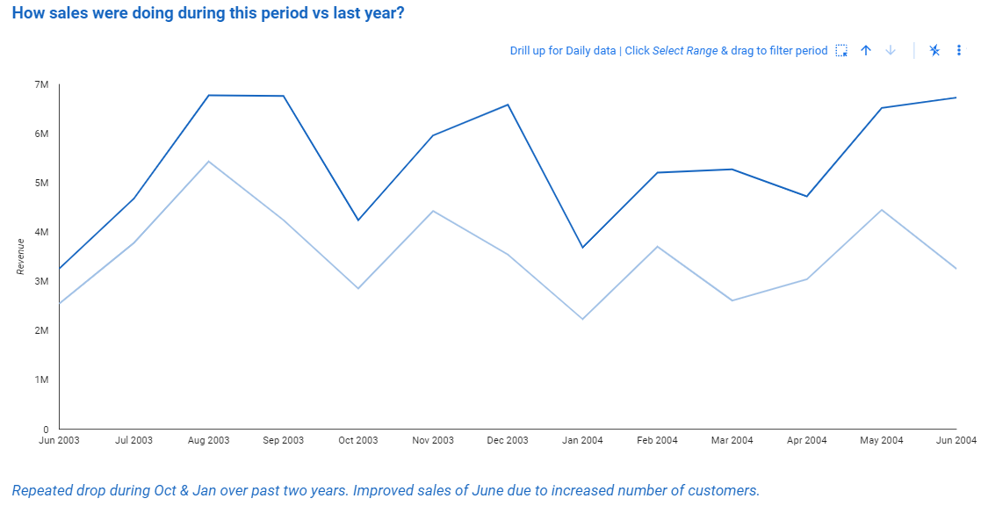
Overview: Current vs last year revenue
Improved sales for June (due to increased number of customers)
2003-06 – 2004-06
Past year comparison
Repeated drop during Oct & Jan (seasonal)

Slide 3
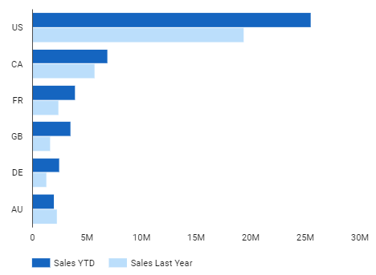
Current vs last year revenue per location
- Overall revenue has improved in most locations compared to last year (due to increase of customers)
- Australia is the only country where revenue has decreased

Slide 4
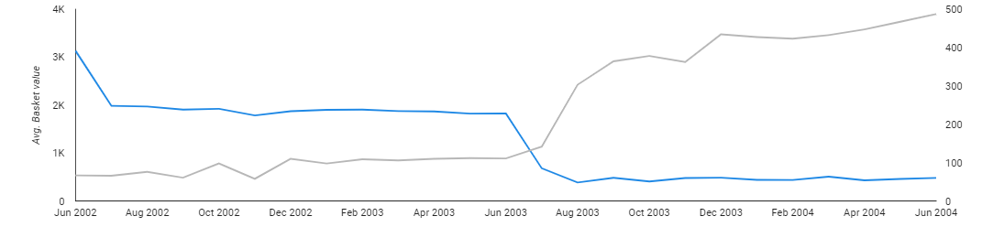
Cause of Australia’s revenue decrease this year
During whole period number of customers (orders as well) was increasing
Major drop of customer basket value from Jun 2003. Main reason: decreased prices
Avg. Basket value
Number of customers

Slide 5
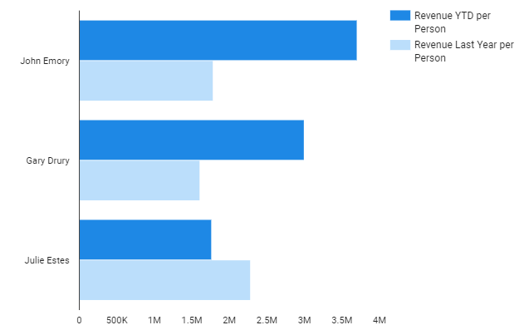
Sales efficiency & bonus per manager
Highest efficiency, lowest bonus per person
Lowest efficiency, highest bonus per person.
*1 sales person in a team

Slide 6
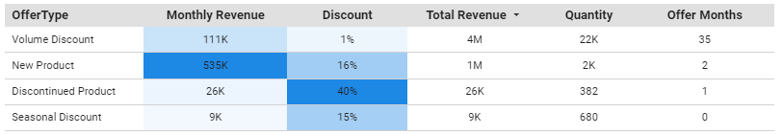
Discounts’ performance
Seasonal Discount
Should be prolonged - did not last for full month. Potentially would generate more monthly revenue
STRATEGY: Adjust

Slide 7
Conclusions & Recommendations 1
Conclusion
Recommendation
01
Price reduction in Australia concequenced in lower revenue this year
Optimize price which would maximize attraction of customers and customer basket size
Julie Estes team had highest bonus and lowest revenue per person
02
Distribute bonus accordingly to the benefit brought to the company by employee. Increase # of salespeople in this team
03
Seasonal Discount campaign brought comparatively low monthly revenue
Prolong this campaign to last at least a month to bring more significant effect

